Slide 1
Theological Education and Ministerial Preparation Willie Edward Hucks II Associate Ministerial Secretary General Conference of Seventh-day Adventists
General Conference of Seventh-day Adventists

Slide 2
Thorough Preparation Necessary
Thorough preparation of candidates for ministry is an essential task for guaranteeing the unity of the church’s message and mission.

Slide 3
Role of Ministerial Secretary
While universities and seminaries develop curricula for their theology and ministerial students, the ministerial secretary should remain aware of and contribute to what transpires in ministerial preparation and theological education.

Slide 4
Areas In Which the Ministerial Secretary Should Contribute
Ongoing spiritual growth mentoring
Curriculum development
Recruitment
Placement

Slide 5
Ministerial Training Process
3-4 years undergraduate degree in theology or religion
1-2 years of a field-based internship under the direction of an intern supervisor-trainer
2-3 years seminary degree
3-4 years of field assignments in preparation for ordination

Slide 6
Field Assignment Leading to Ordination
Provides young ministers opportunities for on-the-job development that exceed the internship that transpired during university studies – development that cannot take place in the classroom.
Ideally 1-2 years between university and seminary studies better prepares the young pastor to see the value of further study. He can better apply classroom learning to real-life situations.

Slide 7
Intern Supervisor Trainers Needed
Such Trainers should possess necessary skills to pass along their spiritual, evangelistic, nurturing, and administrative proficiencies.

Slide 8
Cautions
Pastors of large churches are not necessarily the best candidates for supervising, training, or mentoring young pastors.
Young pastors should not be assigned to a given church simply because an associate pastor is needed. Doing so defeats the purpose for placing a trainee in such a setting.

Slide 9
Ellen G. White Counsel
“In gaining a preparation for the ministry…[the young]…should be associated with older ministers. Those who have gained an experience in active service are to take young, inexperienced workers with them into the harvest field, teaching them how to labor successfully for the conversion of souls….

Slide 10
Ellen G. White Counsel (continued)
“…Kindly and affectionately these older workers are to help the younger ones to prepare for the work to which the Lord may call them. And the young…in training should respect the counsel of their instructors, honoring their devotion, and remembering that their years of labor have given them wisdom.” (Gospel Workers, 101)

Slide 11
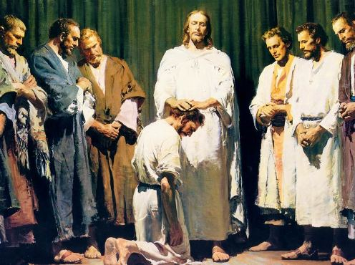
Looking Ahead to Ordination
Conference leaders are responsible for adequately preparing candidates for ordination within this 10-year timeframe.
Ordination is the church’s recognition of God’s call to ministry upon the life of the pastor. It is not a reward for a lifetime of service.
If a candidate is not ready for ordination within this 10-year timeframe, that pastor should be counseled to seek another line of work.

Slide 12
Final Counsel
The ministerial secretary should clearly explain to unordained workers the process leading to ordination. Interns should receive updates annually.
Marriage is not a requirement for ordination.
An appropriate ordination service is outlined in the Minister’s Handbook.

